Slide 1
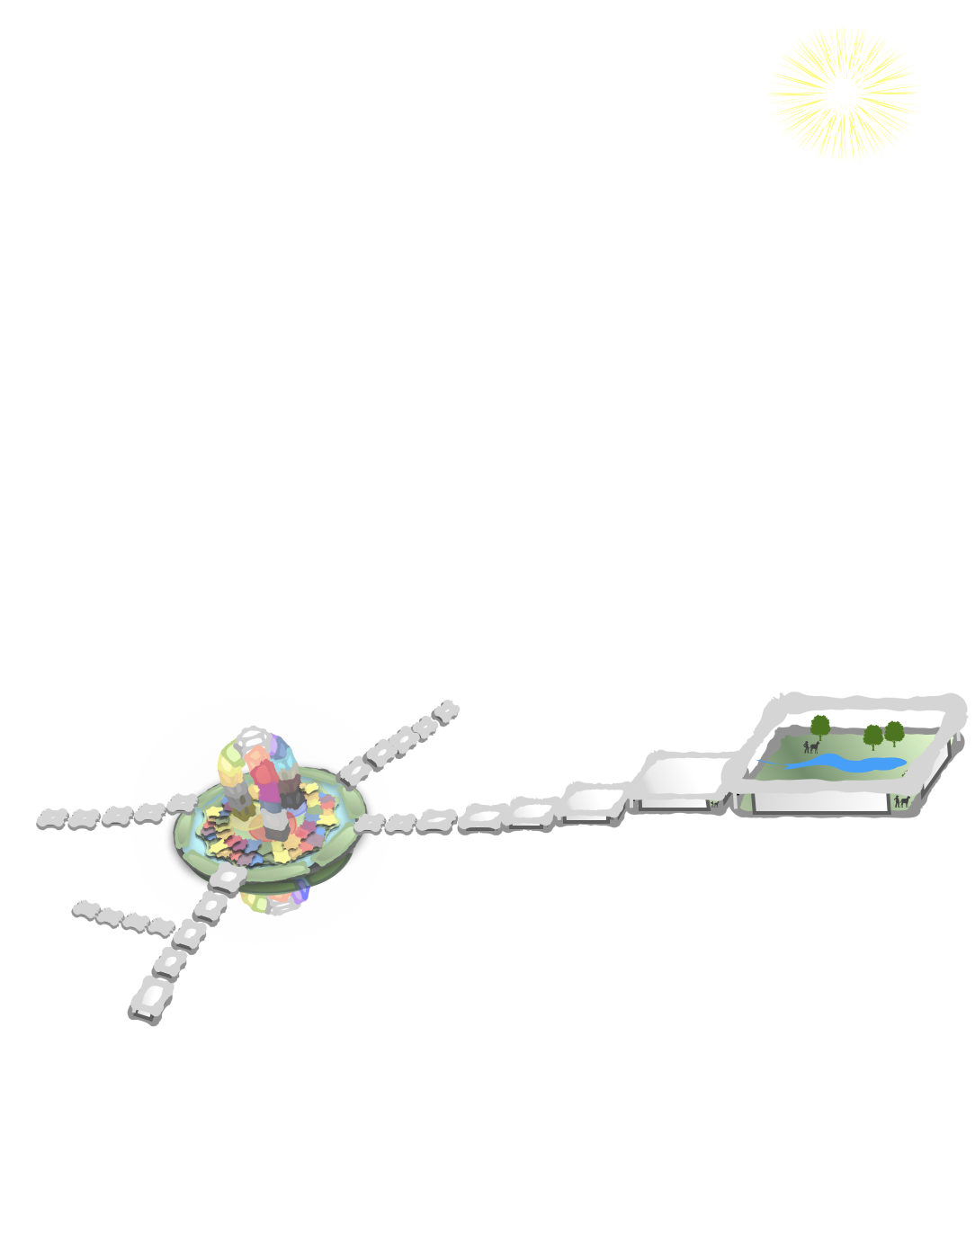

Online Concept Exchange
Spring CS 499 Senior Design Project

Slide 2



Introduction
Stephanie Fairchild Fister
teacher
creator of The Human Domino Effect
Problems
lack of at home learning environments
not much emphasis on learning mindset
Initial Scope
create website called the Online Concept Exchange inspired by The Human Domino Effect Game

Slide 3
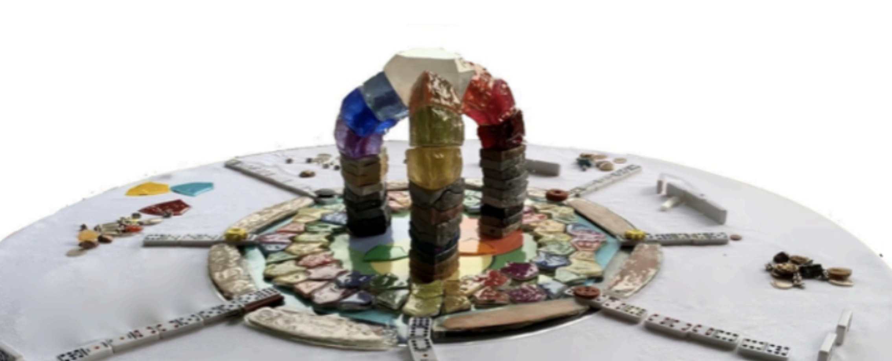
The Human Domino Effect Game
Level One: 3 circle Venn diagram of Health, Liberty, and Happiness
Level Two through Four: 60 human footprint tiles that tell our collective history
Levels Five and Six: 9 building blocks on how to live and 9 arching blocks on the branches of human knowledge
Level Seven: a project to imagine and contribute to a better future in your community
Notes:
Jalen
Feedback: Add emphasis on how parents can use the website to build skills as well and not just the kids

Slide 4
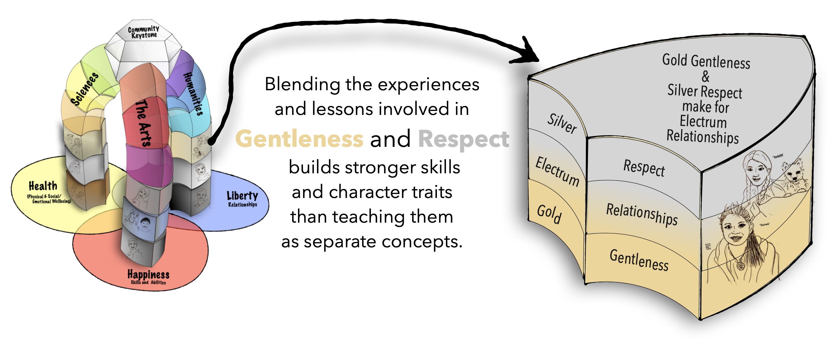

Project task
Resource Site
access information and resources for each of the 9 how to live building blocks
geared towards parents
Forum Site
create & edit posts with home learning environment ideas
Notes:
Ryan W

Slide 5
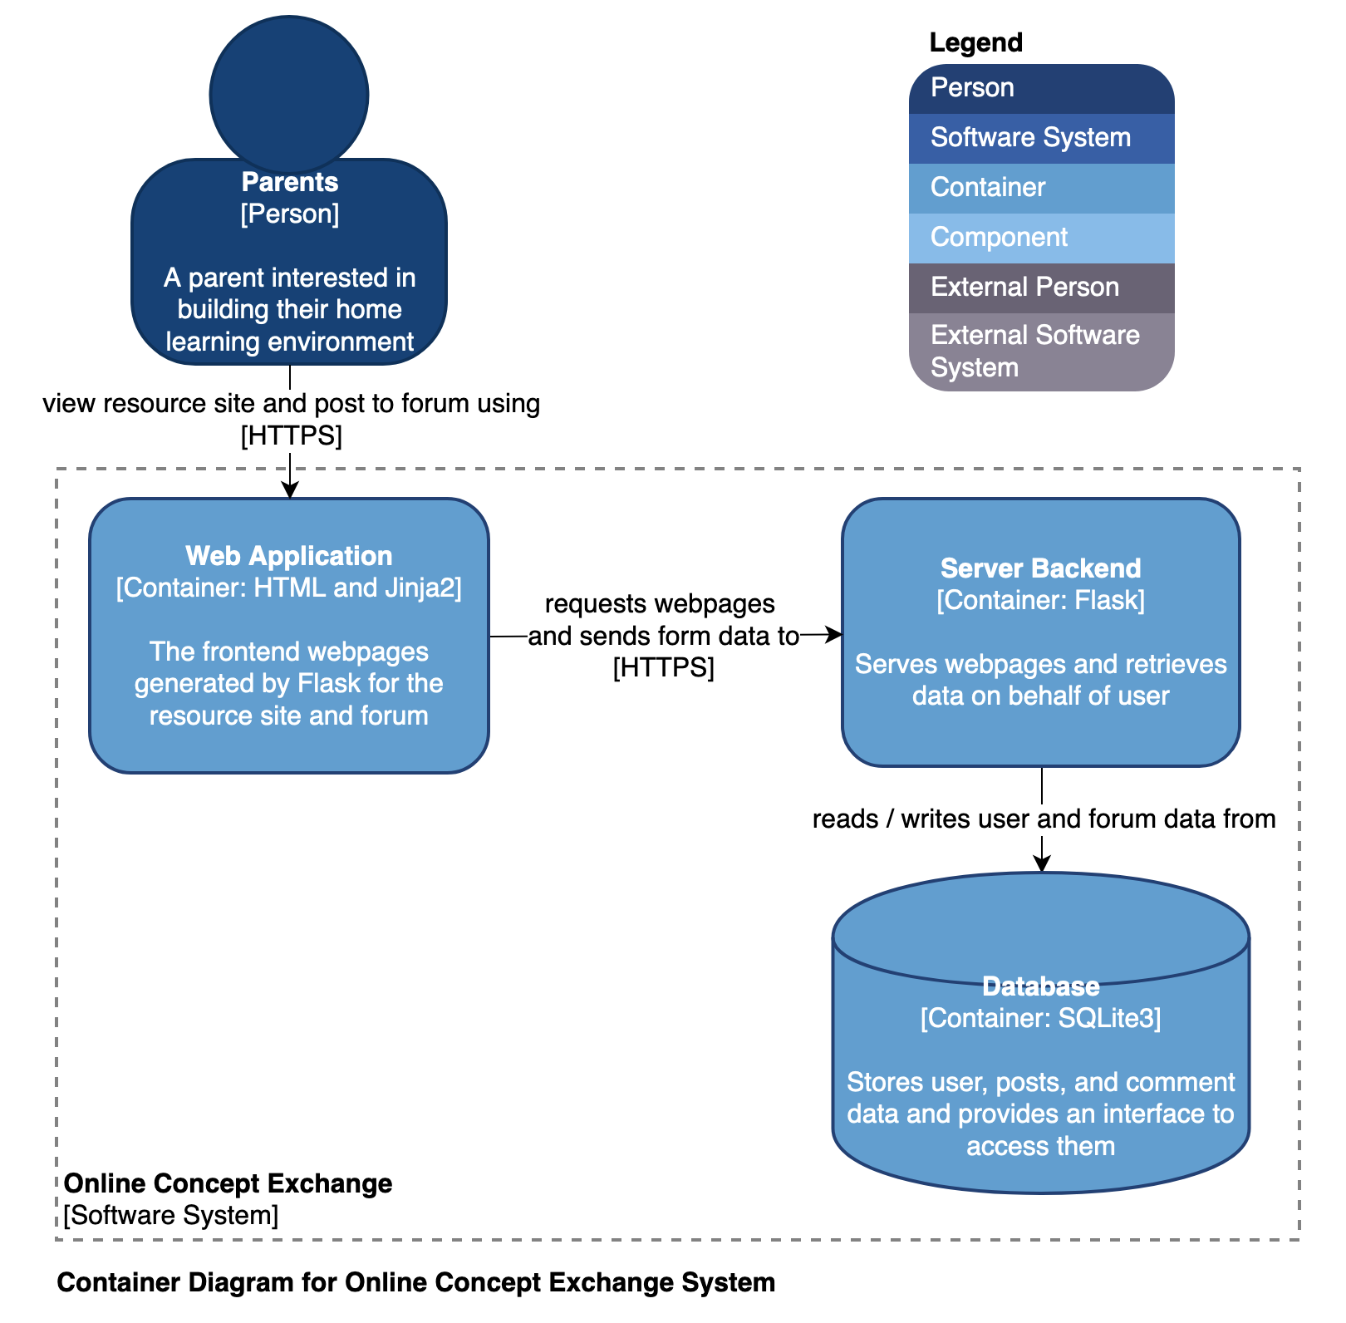
Architecture
Server Side
Flask Web Microframework
Jinja
Client Side
HTML + CSS + JS
Bootstrap
Database
SQLite3, development
Notes:
Nyx

Slide 6
Demo
Notes:
Ryan Z

Slide 7
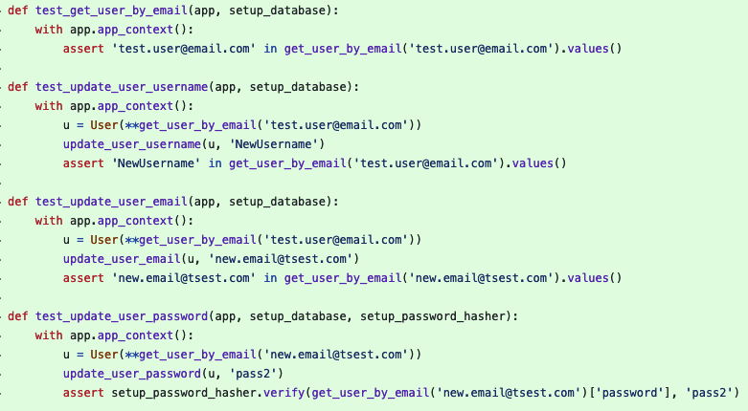
Testing
Frontend Testing
page layout realigns to be mobile-friendly
game board and nav-bar route to expected pages
Backend Testing
tests create-read-update-delete functionality for different features
Defects Outstanding
some links are not yet used
unit testing not complete
Notes:
Ryan W

Slide 8
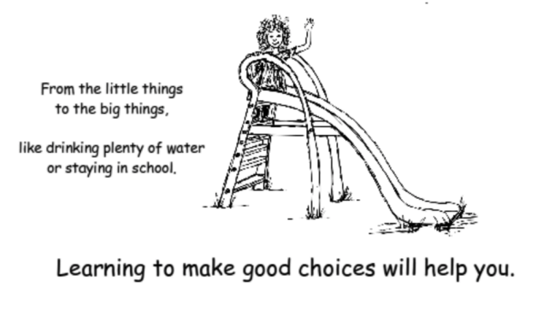
Lessons Learned
Aggressive development approach was needed
Staying in scope and managing time spent on project tasks is difficult
Managing GitHub Issues and sprints was new for us
Requirements can change as the project takes shape
Notes:
Aubrey

Slide 9
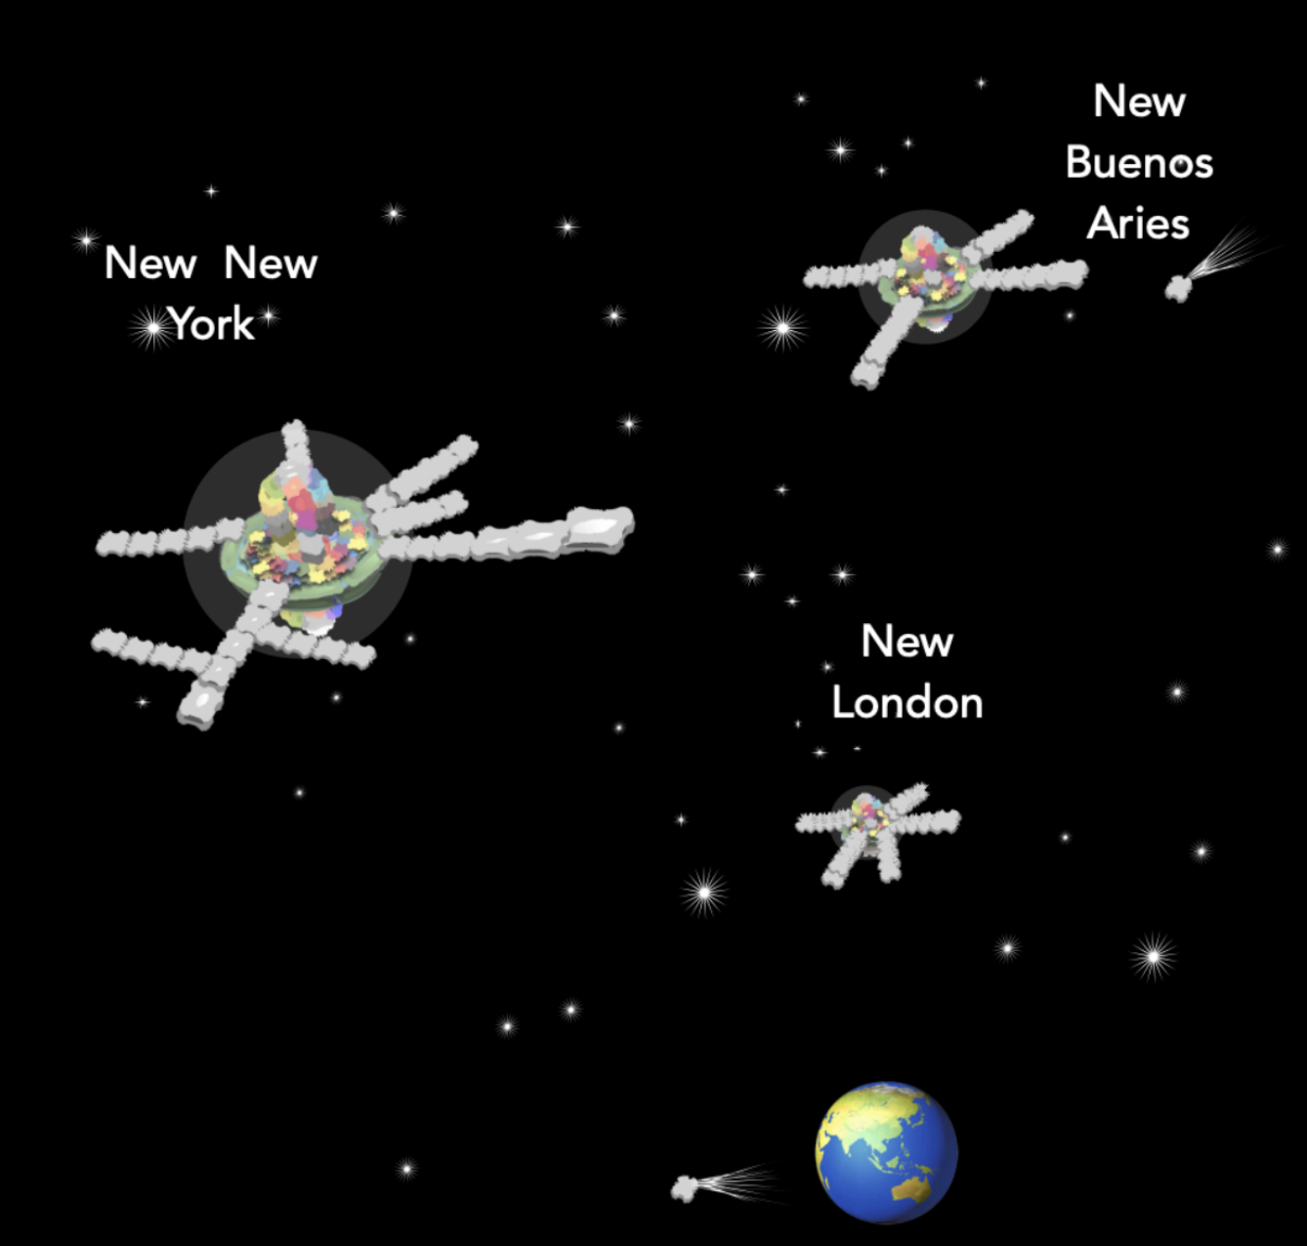
What’s Next
Forum
add bulletin board or discussion posts
put safety and security first
Hosting
use previous domain and add advertising
New Cities
add resources on block pages that are relevant for new cities
Notes:
Aubrey

Slide 10
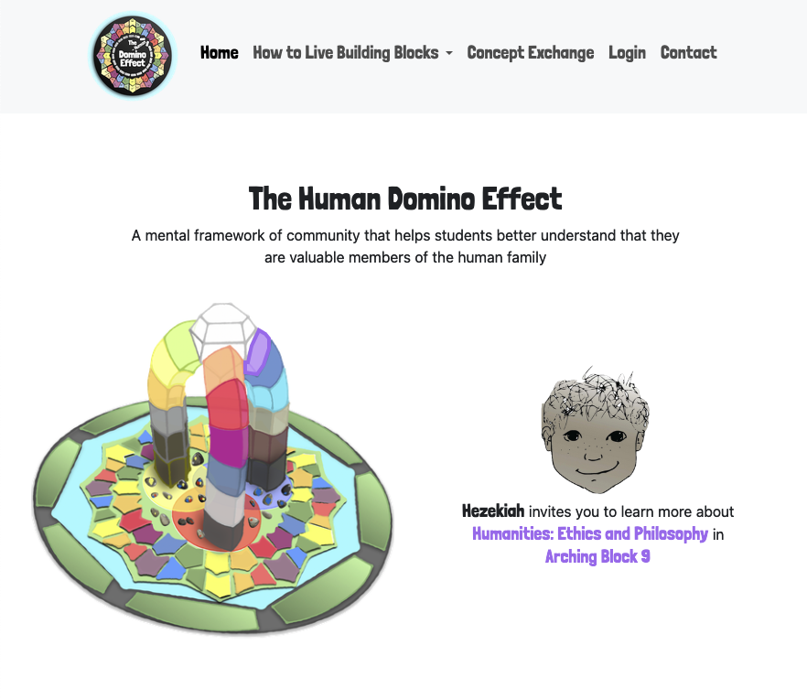
Conclusion
Home Page with Interactive Board
captures the image and spirit of the game while assisting with navigation
Nine Block Pages
provides information on how to learn and live
Forum Foundation
ready-to-use code for forum features, including account and database creation
Notes:
Brett

Slide 11
Questions

